Slide 1
The Four Shifts Framework

Slide 2
About the Four Shifts framework
The Four Shifts was created by Collaborate CIC to support the evaluation of Making it Happen as a clear and accessible tool to help us to capture and analyse evidence about the change MiH is contributing to for individuals, communities and in the wider system.
Making it Happen is an asset-based community development programme operating in 5 areas of East Sussex. It is funded by East Sussex County Council and delivered through a partnership of five local VCS organisations
3VA
Action in Rural Sussex
Hastings Voluntary Action
Rother Voluntary Action
Sussex Community Development Association
Community development workers work alongside people to build on the positive things happening where they live and build the relationships, connections and networks that will contribute to positive change.
.
Notes:
The Four Shifts framework was created to support the evaluation of MiH by Collaborate CIC
MiH is an asset-based development programme working with communities in 5 areas of East Sussex and run by a partnership of organisations led by Sussex Community Development Association, who are working with 3VA, Action in Rural Sussex, Hastings Voluntary Action and Rother Voluntary Action.
When thinking about how to evaluate the programme, we wanted to create an accessible and clear tool tying together different elements of the evaluation to help us collect and analyse evidence about the impact MiH is having for individuals, communities and how it might be influencing the wider system.
The response to the framework has been really positive.

Slide 3
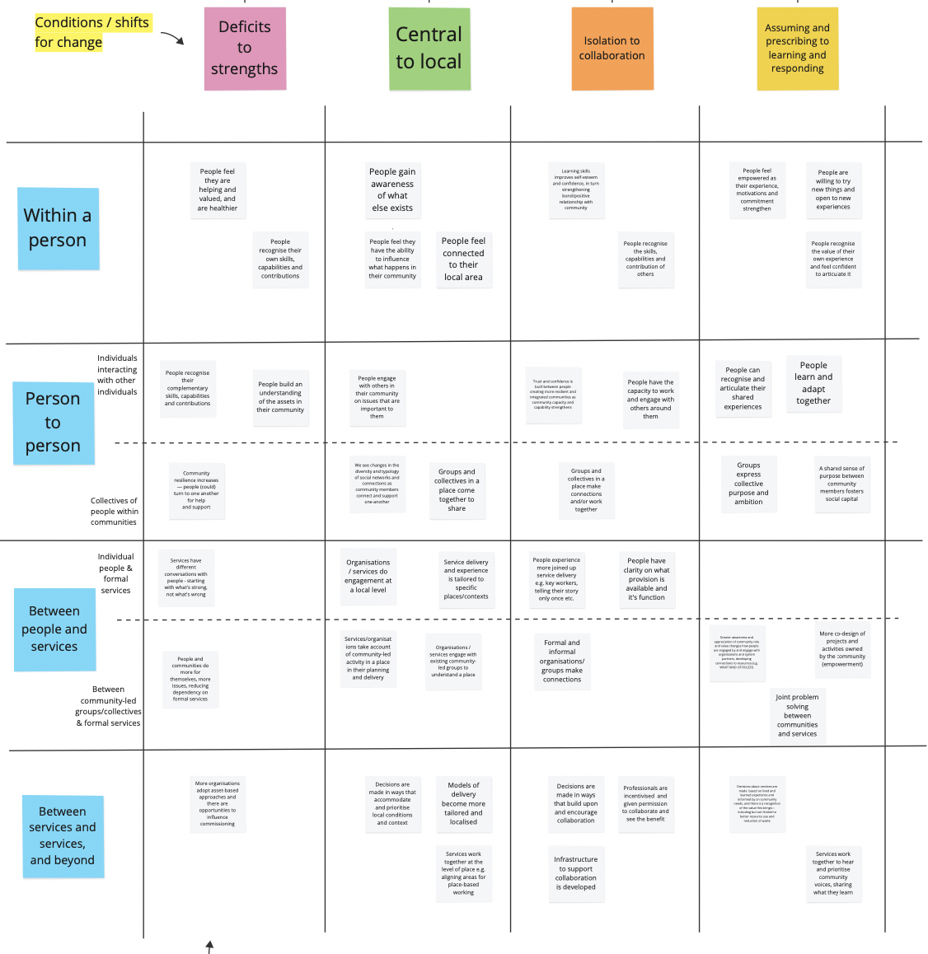
The key components of the framework are:
The four shifts (along the top)
The four levels (down the side)
The indicators (on white squares in the boxes)
Notes:
This is a very small version – hopefully you can see a larger printed copy nearby

Slide 4
The Four Shifts
Deficits to strengths
From focusing purely on needs and deficits to consideration of the strengths and assets that are already present
Central to local
From central ‘one size fits all’ type responses to locally defined solutions and action
Isolation to collaboration
From isolation and silo working to collaboration across different actors and organisations
Assuming and prescribing to listening and responding
From pre-determining what people need or offering a ‘set menu’ of options, to deep listening and co-production

Slide 5
The Four Levels
Within a person
Changes in how an individual person behaves or perceives themselves
Person to person
Changes in how individuals interact with other individuals in their community
Changes in how collectives of people within communities interact, behave or perceive themselves
Between people and services
Changes in how individual people and formal services interact
Changes between how community-led groups/collectives and formal services interact
Between services and services, and beyond
Changes in how formal services and the wider system interact with each other and the community

Slide 6
Example indicators
People feel they have the ability to influence what happens in their community
People engage with others in their community on issues that are important to them
Organisations / services engage with existing community-led groups to understand a place
Within a person
Decisions are made in ways that accommodate and prioritise local conditions and context
Person to person
Between people and services
From central to local
Between services and services

