Slide 1
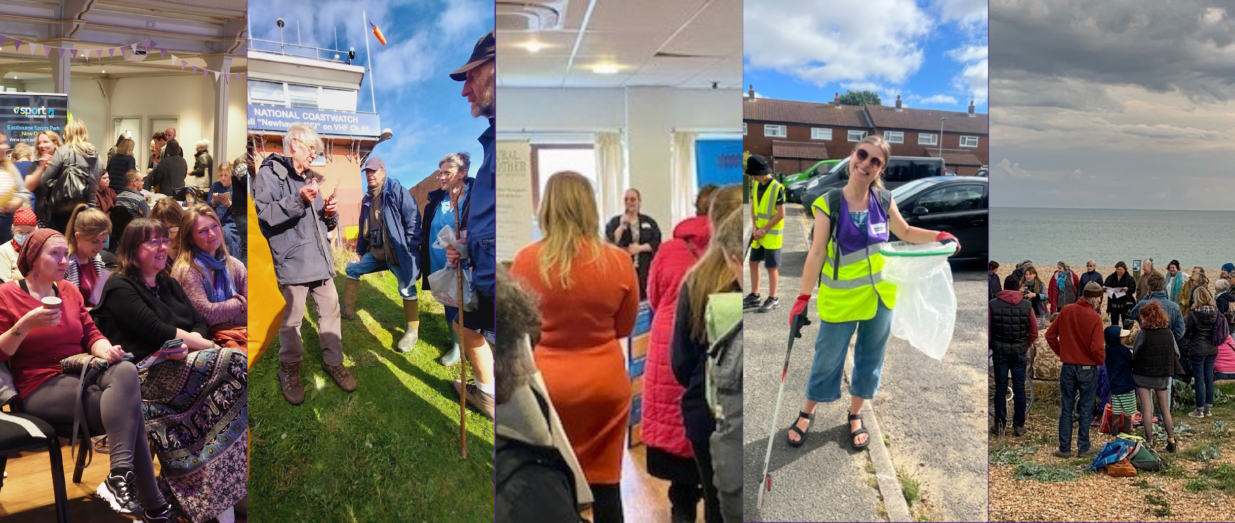

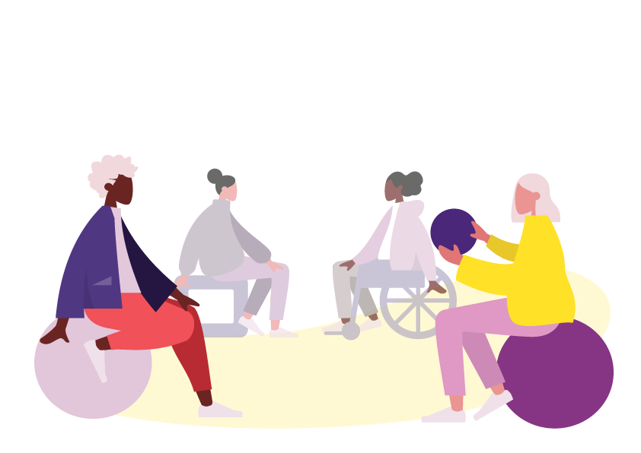



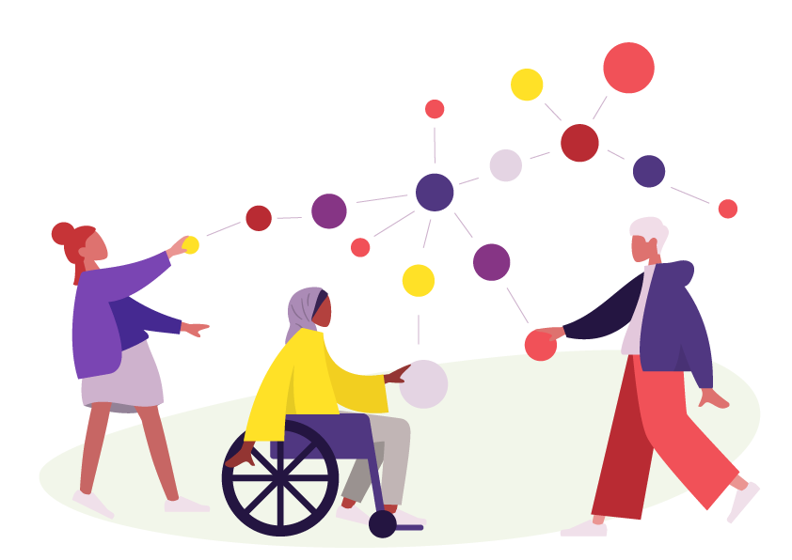

Building community power in practice: How the people of East Sussex have ‘made it happen’
Penny Shimmin (Chief Executive, Sussex Community Development Association
Steve Manwaring (Chief Executive, Hastings Voluntary Action
Terry Hume (Public Health, Healthy Communities and Places, ESCC)
Partnership Plus Full Group, 18 July 2025

Slide 2




What we wanted to see
Improved wellbeing and reduced health inequalities through:
  Supporting communities to take collective action on health through Asset Based Community Development
  Encouraging the growth of community-centred and asset-based practice in the VCSE though grants awards
  Improving people’s practice in asset-based approaches
A consistent approach to delivery across service provision / process across the county at the start
A learning approach that helped to understand what works, for whom, why, and under what circumstances
Contribution to influencing and supporting wider systems change, including what ways community involvement in decision making is enhanced (if, and in what ways, MiH contributed).

Slide 3
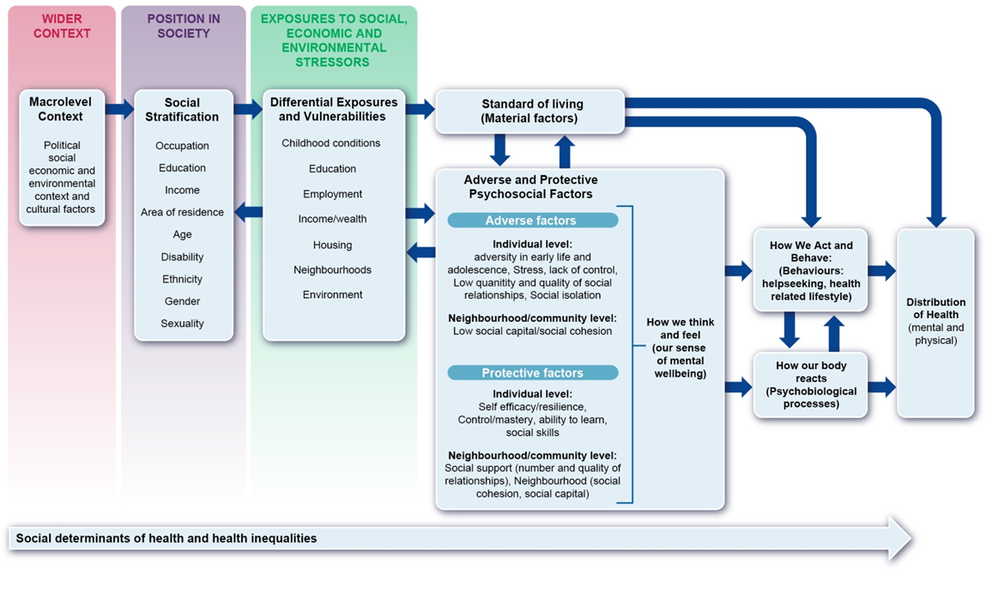
Protective factors

Slide 4
What we have seen already
Without question MiH is deploying ABCD effectively to support people to improve wellbeing, make connections, initiate activities, bring community assets into use.
No shortage of ideas and passions from people for change they’d like to see. Whilst there were common themes, it matters that activity was particular to and emerging communities.
The grassroots, participatory, peer focus, and centring of lived experience, is laying the foundations for exercise greater voice in other arenas in the future.
Lack of access to physical spaces is one of the greatest sources of anxiety and frustration (everywhere, but particularly in rural areas).
Interactions between ‘strategic’ stakeholders and MiH were largely one-way transactions - i.e. looking to benefit from connections more so than building collaborative and reciprocal ways of working.

Slide 5
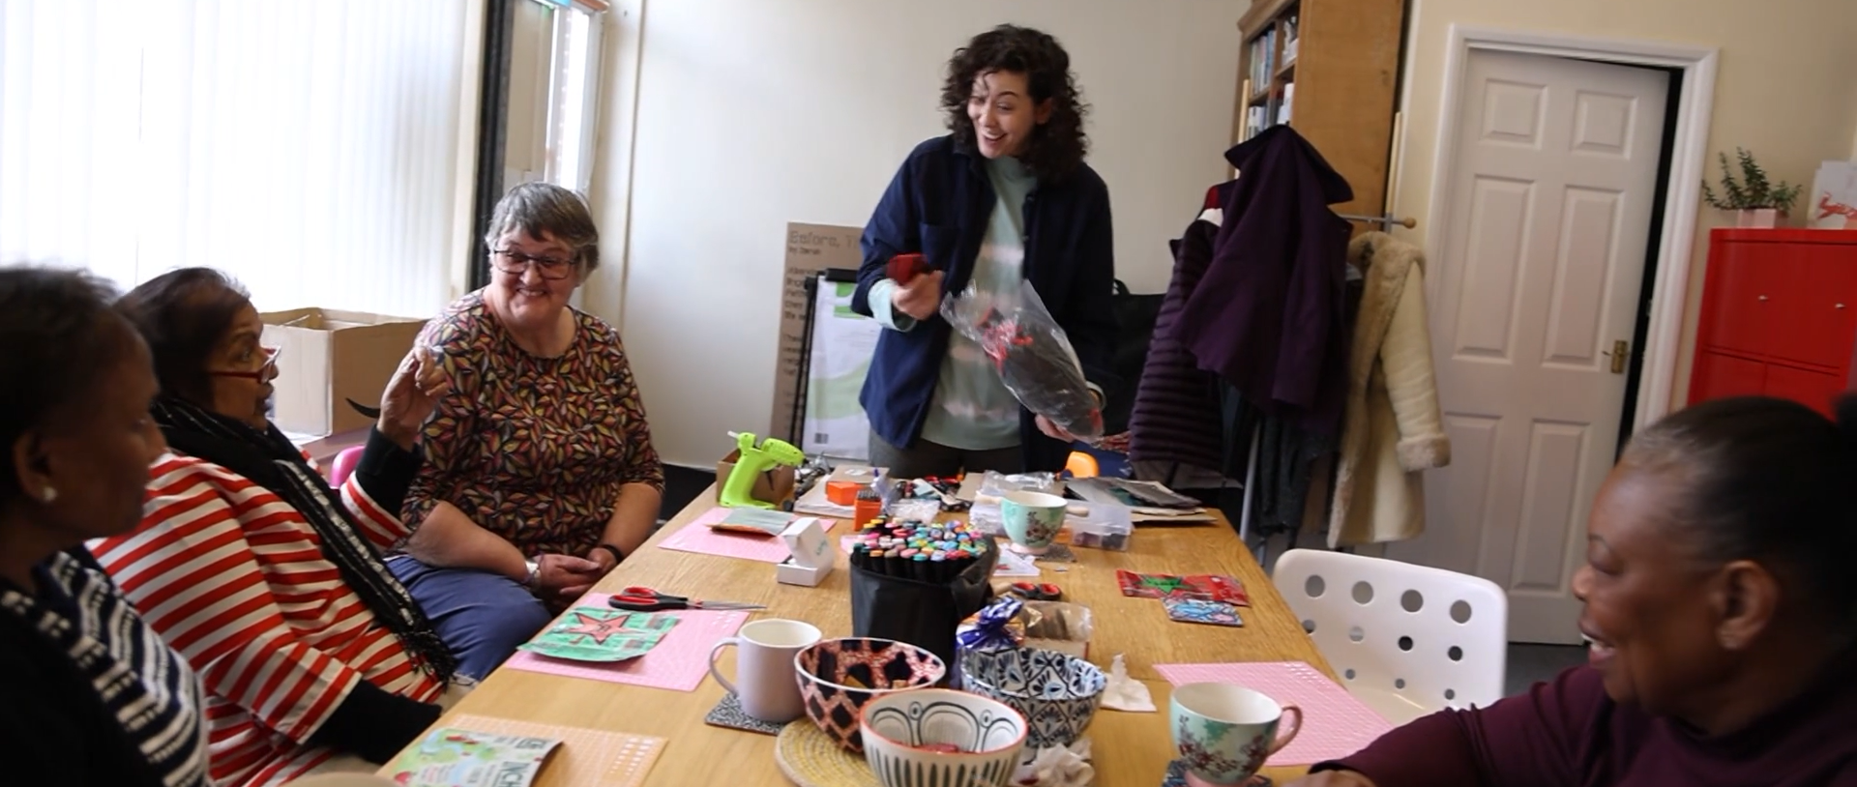
Building Community Power in Practice

Slide 6
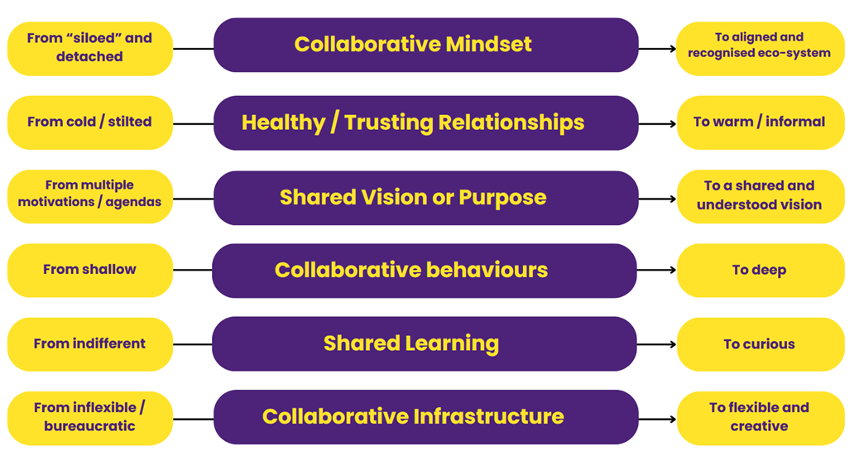
Partnership working

Slide 7
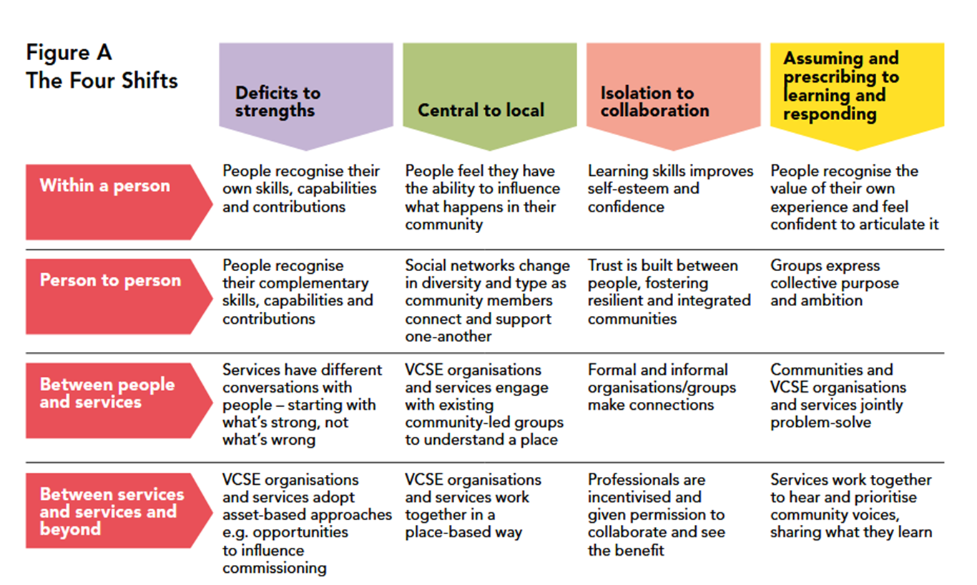
Analytical framework

Slide 8
What we have seen the most of
‘East Sussex has become a hotspot for modelling and expanding asset-based practice and principles, revitalising and cultivating assets and community infrastructure in communities, and instilling a culture of collaboration and learning across the system’
Improvements in individual wellbeing (often transformational)
Thicker social capital (strong levels of social connections characterized by high levels of trust, cooperation, and shared values).
People gaining confidence, capability, and control over their lives.
More collaboration - cross-pollination, linking across, and sharing of resources between groups.
Improved community spirit (the feelings of connection and belonging to a community and the ability to come together to improve wellbeing for everybody.)

Slide 9
What have we seen less of
Examples in which connections between diverse and dissimilar groups resulted in improved understanding. Less ‘bridging’ social capital was seen with the majority of examples showing less mixing across groups.
Generative interactions between MiH activities and ‘higher levels of the system’. Albeit this is through piecemeal engagement and does not appear to extend all the way to joint problem solving between communities and services.
Clear strategies for influencing wider systems change in a notable way was not seen during the programme.
There was only limited anecdotal reference in evidence reduced need for services - people feeling less of a need to engage with statutory services, such as GPs, as these are replaced with community-based support.
Whilst the conditions for this was found to be created (identification of shared experience and creation of shared narratives), evidence of collective voice at a neighbourhood level was limited.

Slide 10
Why we think this was seen – a way of working
“Making it Happen isn’t just a programme – it’s a way of working that values the passions, skills, and drive of local people.” “I would say that for the majority of us workers this programme has changed our vision of the world”.
Deep listening allowed space for people to define their own journey, drawing attention to symbiotic potentials of new connections.
Flexible and trust-based support enabled people to grow ideas, build confidence, and lead change in their own ways.
Through reciprocal relationships, the idea that nothing can change was challenged enabling the building a sense of community spirit.
People to discover untapped assets within themselves. These discoveries constituted affirmations of the value of people’s contributions, often leading to the development of new leaders.
The presence of CDWs mitigated against divisiveness between groups and other stakeholders, often making collaborative projects stronger.

Slide 11
Why we think this was seen – the CDW role
‘It’s easy to talk about building on ‘what’s strong not what’s wrong’, listening, and allowing space for community leadership is harder to do in practice.’
A crucial element of MiH’s success is how the ‘whole way of working’, with the blended CDW role at the centre and the cumulative effect of different aspects of the role (community engagement, mentoring, facilitation, grant giving, social pedagogy, knowledge generation, stewardship, ‘holding-the-line’-buffering against extractive activity).
CDWs entire focus is on supporting communities without specific agendas which contributed to authentic and equal relationships..
CDWs have taken a lightly facilitative, elastic way of holding space, creating environments where what people want for themselves emerges.
CDWs became key nodes in broadened networks having identified opportunities for connections between organisations and projects.
The presence of CDWs mitigated against divisiveness between groups and other stakeholders, often making collaborative projects stronger.

Slide 12
Why we think this was seen –learning culture
Centring learning over performance targets impacted on staff motivation, permitted relational approaches, and allowed the values to flourish, and practices to feel ‘organic’, ‘authentic’, ‘human’.
A culture of peer-learning proliferated skills-sharing and reciprocal teaching with communities leading learning and embedding ABCD locally, treating knowledge as an informal process of collective inquiry.
Increased awareness of other asset-based projects and ‘permission’ to collaborate and connect with different groups and projects.
External acknowledgement of MiH as generating emergent learning that others can and should engage with.
Creating a safe-to-fail environment allowing groups to try small scale experiments and take forward the learning (this gave confidence to try something new with low levels of risk in failing, whilst allowing people to feel comfortable in sharing what did not work).

Slide 13
Why we think this was seen – lived experience
People felt welcome in non-judgmental , welcoming spaces where people felt safe, seen and accepted. Most often this was born out of solidarity through shared experience.
People with lived experience or facing barriers have been the ones to identify and codesign activities to address them.
People experiencing stigma, discrimination and exclusion have redefined new narratives of their experiences, creating new possibilities, and finding meaning even in small actions.
Groups supported have tried their best to account for intersectionality, despite limitations to how much influence they can have.
Everyone was seen to have value and that self-actualisation is connected to community-actualisation. This runs counter to many models for understanding wellbeing which are more individualising.
Notes:
Black feminist scholar Kimberlé Crenshaw coined this term in 1989 to describe how forms of discrimination based on someone’s race, class, gender and other aspects of their identity intersect and compound to create “interlocking oppressions”(or privilege)

Slide 14
Why we think this was seen – the ‘System’
Whilst acting as local system stewards within the communities, CDWs has less capacity for strategic engagement at wider geographies and felt that this required a different skill set.
There have been some efforts to engage senior stakeholders in the system about MiH’s work and there appears to be a developing understanding and appreciation for ABCD.
Some individuals have meaningfully applied asset based practice to their responsibilities. Where this is seen, those doing so are starting to realise the benefits of this way of working.
The evaluation encountered examples of decisions made that directly affected the community but without their involvement or extractive (relationally damaging). Aswell as examples indicating that people had not grasped what working differently really looks like in practice.
New approaches require time and capacity to grasp and those already working within overstretched systems often struggle to engage with what is beyond their immediate responsibilities.

Slide 15
Recommendations

Slide 16

Ensure future programmes and engagement with communities heeds how and why the programme has worked, considering the preference for experiential and dialogue learning that continues to enable voices and perspectives that have been marginalised to be heard.
Ensure ‘asset-based’ programmes / organisations adopt a learning approach, focusing less on point-in-time/post-programme evaluations and more on learning and developing as needs arise.
As opposed to scaling up or scaling out, to scale deep - focus on the “deep personal and broad cultural transformational work” that is required to create durable systems change”.
Consider how to mitigate against the risk of reduced trust accompanying cyclical funding to maintain relationships and whatever trust that has formed through this programme.
Recommendations

Slide 17
Recommendations
Earlier recommendations further substantiated in the final phase:
Consider how accessible, shared physical spaces can be further supported as a prerequisite for community action.
Explore how to broaden social networks across demographic differences, including intergenerationally.
Encourage more reciprocal relationships, rather than one-way or transactional relationships.
Explore the boundaries and balance of what a community can do for itself, versus where professional (e.g. clinical) expertise is needed (including a mature conversation about risk).
Provide ‘ABCD’ ‘training’ and capacity building for future practitioners, communities, and people working in services. Enable learning at a whole community level, rather than project level. And embed learning in the fabric of the VCFSE more effectively.

Slide 18
What we are seeing elsewhere

Slide 19
More evidence available, including why things work. And Increased examples of spreading, scaling and deepening approaches.
Convergence of thinking on centring communities (OHID, NICE, Kings Fund, Health Foundation, RSPH, NHS Confed, LGA, 10 year plan, ADASS Roadmap, Social Care Future, National Lottery, Sport England, DCMS, DLHC, New Local … )
Neighbourhood health guidelines and the Model IICB Blueprint v1.0 includes systematic and meaningful involvement and co-design.
Increased evidence of relational approaches to public management, e.g. Human Learning System coalition involving 300+ members and rich case studies cohort.
‘Crisis of powerlessness’: recent polls show that 84% of people said they felt powerless, up from 71% in 2018. 75% said giving power to local people would help restore trust in politics. (We’re Here).
Evaluation
Findings
The ABCD Approach
What we are seeing elsewhere in the UK

Slide 20
Increased projects using participatory, community-led and salutogenic approaches, e.g. Mr Hastings and St Leonards.
Mr Hastings and St Leonards has similarly aimed to support a sustained, effective collaboration for social change though a shared collaborative lens, asset-based principles and using learning to drive change. The evaluation broadly supports the key MiH findings.
Increased reference to asset based approaches in strategies documents (e.g. ASC prevention strategy actively exploring how to build on the learning and practice of MiH).
Increased number of projects using elements related to a Complexity Theory of Outcome Creation (The Loneliness Programme stewardship plus at least half a dozen more).
The Community and VCSE Development Programme continues the aim of strengthening the shift to more person-centred and community-based approaches to health and wellbeing. The programme will seek to mobilise assets, encourage equity and connectedness, and increase people’s control over their health and lives.
Evaluation
Findings
The ABCD Approach
What we are seeing elsewhere in East Sussex

Slide 21
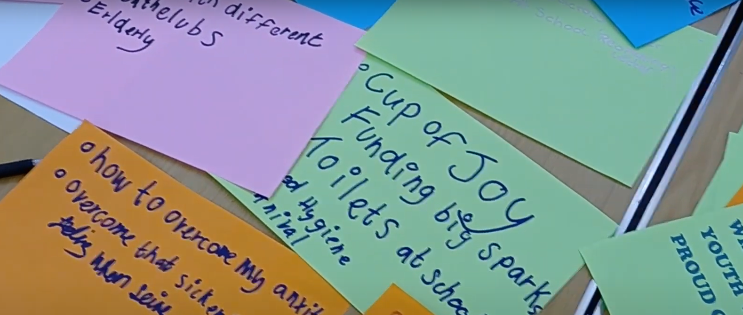
TAKE HOME MESSAGES

Slide 22

Summary
The outcomes seen are supported by, and support, the wider evidence.
A focus on ‘Learning as a Management Strategy’ influenced outcomes at least as much as a strengths-based lens to practice.
ABCD is cross-sector collaboration (typically at a geography). It is not a VCSE way of working. It’s a whole neighbourhood approach linking communities, VCSE services, housing, schools, GPs, police, business…
MiH Neighbourhoods were based on ‘natural neighbourhood concept’ with population sizes starting at circa 5,000, allowing for relational approaches to lead to more transformational change.
MiH has sought to model a ‘Human’ ‘Learning’ Systems’ approach. To ensure its legacy a final learning cycle should be stewarded to enable sensemaking of the programme end ‘how and why’ insight.

Slide 23
  What are you seeing?
  Questions or thoughts on findings?
  Comments on the recommendations?
  Suggestions on ensuring programmes and engagement with communities heeds how and why the programme has worked?
  making-it-happen.org.uk
  Penny@sussexcommunity.org.uk - steve@hastingsvoluntaryaction.org.uk - Terry.Hume@eastsussex.gov.uk

